Slide 1
Global Transcriptomic Profiling Identifies Differential Gene expression Signatures between Inflammatory and Non-inflammatory Aortic Aneurysms
Aortitis RNA-seq meeting
Thursday, June 8, 2021
Notes:
OK. Today, we prepared these slides to introduce some additional analysis that we thought it may benefit our paper.
I believe it is very simple and straightforward, so it wouldn’t take much time to explain.

Slide 2
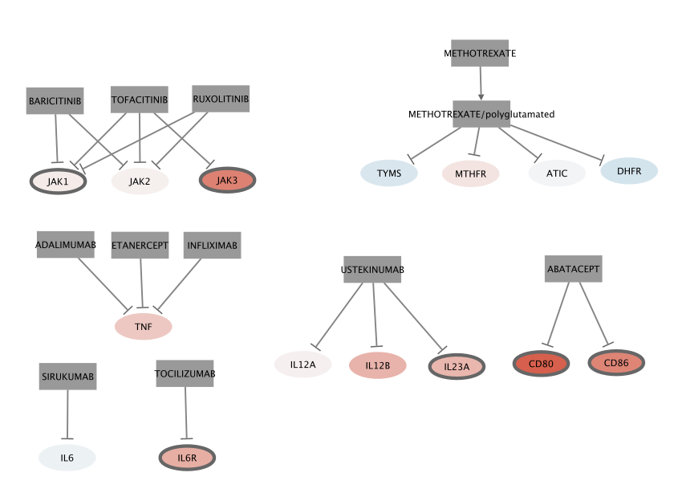
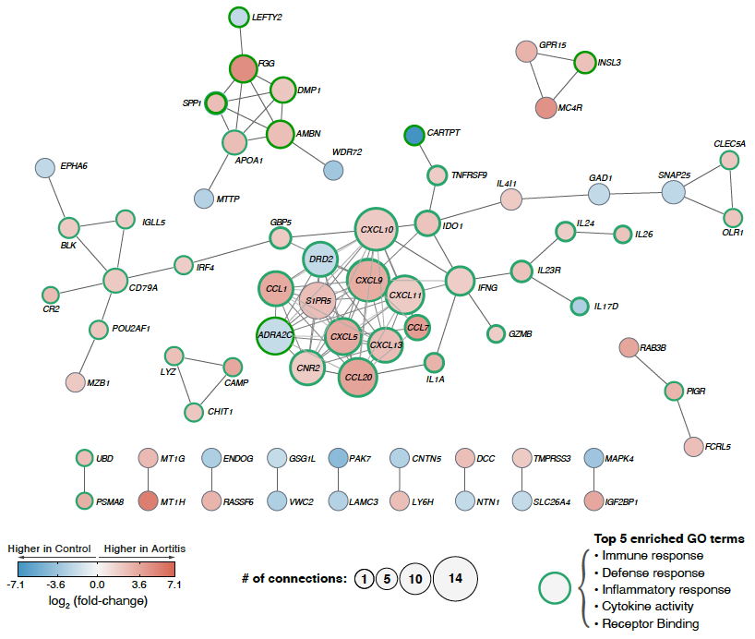
Manuscript outline
Figure 1. Study design, analysis pipeline, and data characteristics.
Figure 2. Volcano plot and functional categories of DEGs
Figure 3. General gene set enrichment analysis for up-regulated/down-regulated DEGs
Figure 4. Heatmap of top 3 enriched GO-terms
(NEW) Figure 5. Gene expression profile of known druggable genes in aortitis (mainly GCA)
SFigure (former Figure 5). Functional protein-protein interaction network of DEGs
Figure 6. PPI-based pharmacogenomic network
1
Notes:
But before that, I will quickly remind what was the outline--figures of the manuscript, and what will be changed.
In sort, We newly add figure that shows the gene expression profiles of the known druggable genes in aortitis.
While the previous figure 5 was moved to supplementary figure.
Other figures, such as Figure 1 to 4, and 6 remains the same.
I’ll get back to figure 5 soon.
(NEW) Investigation of known druggable targets in aortitis
Investigation of hypothetically druggable targets in aortitis

Slide 3
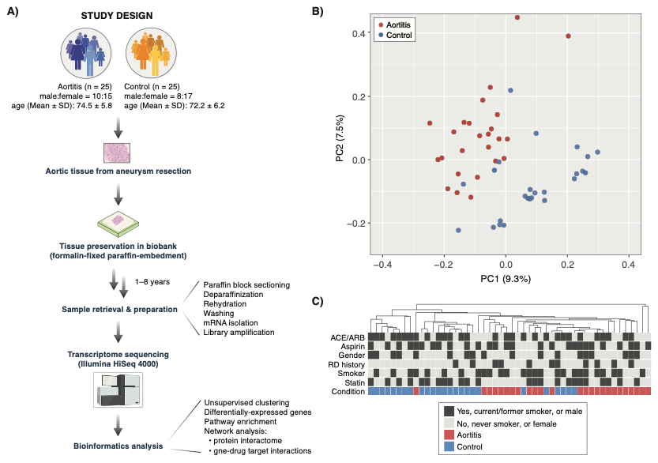
Figure 1.
Figure 1. Study design and data analysis pipeline on genome-wide expression (transcriptome) profiles of inflammatory and non-inflammatory aortic aneurysms.
2
Notes:
This is the figure 1. which we all know.
A figure that illustrates the study design, data analysis pipeline, and the global transcriptome profiles

Slide 4
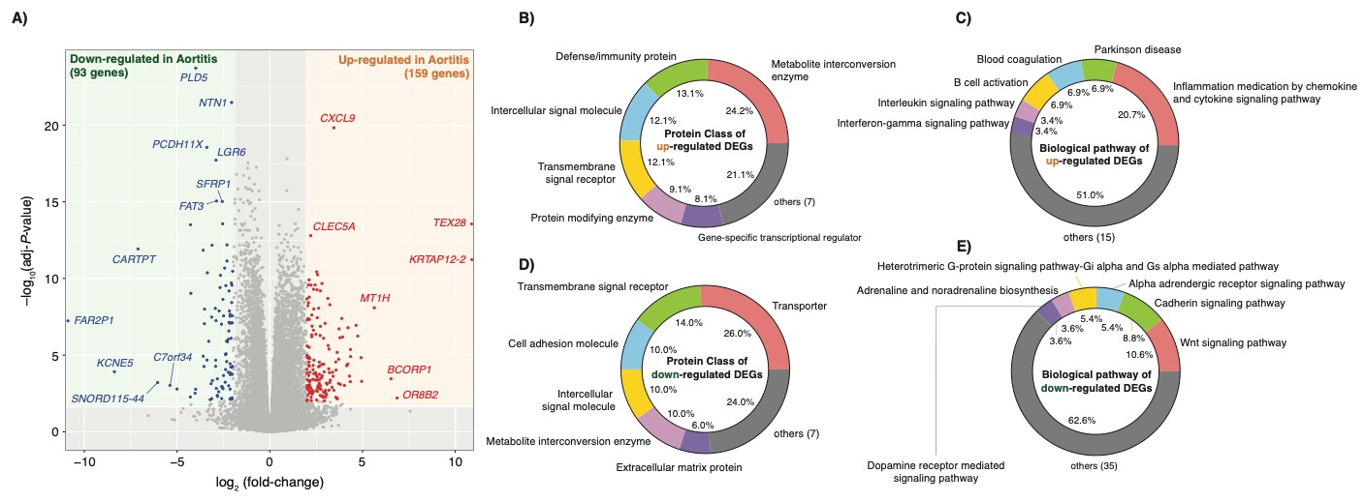
Figure 2.
Figure 2. Differentially-expressed genes (DEGs) and their functional categories reveal transcriptomic signatures of aortitis.
3
Notes:
Figure 2 is about the differentially expressed genes.

Slide 5
Figure 3.
Figure 3. Gene Ontology (GO) enrichment analysis reveals upregulation of immune response genes and downregulation of neuronal activity genes in aortitis.
4
Notes:
Figure 3 is about the GSE analysis of the upregulated and down regulated DEGs.

Slide 6
Figure 4.
Figure 4. Gene expression profiles of the top 3 enriched GO-terms identifies key genes involved in dysregulated molecular pathways in aortitis.
5
Notes:
And Figure 4 is about heatmap of the DEGs.

Slide 7
Investigation of known druggable target genes in aortitis
(NEW) Figure 5
5
Notes:
So, Figure 6 was a figure that discuss new
However, we felt that discussing the ”known druggable target genes” before PPI-based pharmacogenomic network was necessary.
So, we decided to add a new figure---as figure 5---that illustrates the gene expression profiles about the known drug targets

Slide 8
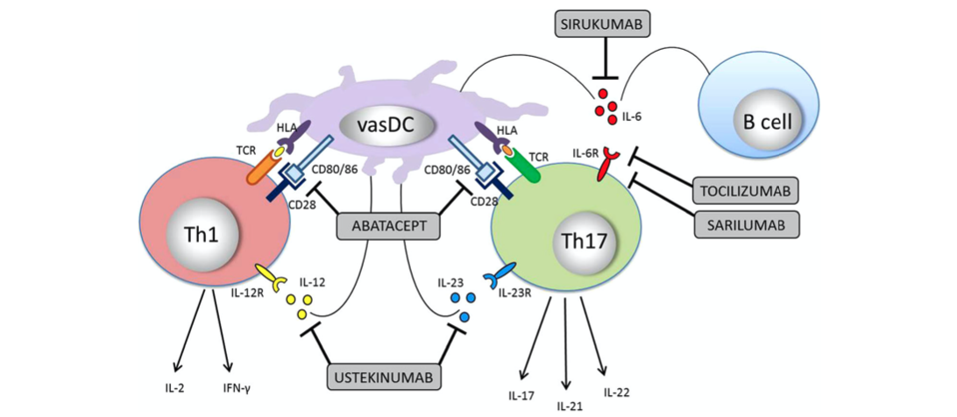
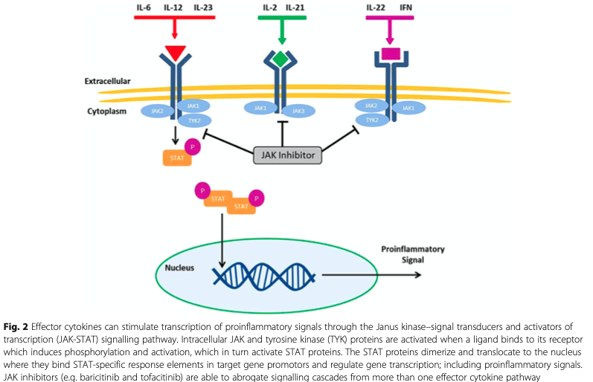
Druggable genes
Focusing on druggable genes that were mentioned by Koster et al., and others
TOCILIZUMAB: IL6R
SARILUMAB: IL6R
SIRUKUMAB: IL6
ABATACEPT: CD86, CD80
USTEKINUMAB: IL12B, IL12A, IL23A
+ METHOTREXATE, INFLIXIMAB, ETANERCEPT, ADALIMUMAB
6
Notes:
The main idea of the druggable genes were obtained from Matt’s paper.
We mainly focused on the genes that were mentioned in this paper.

Slide 9
Known druggable genes
Figure 5. (tentative legend) Gene expression profile of known druggable genes in aortitis (mainly GCA)
Drug interaction info. from:
DGIdb
Koster et al.
Gremese et al.
Bursi et al.
Cronstein et al.
Dejaco et al.
Harrington et al.
Nodes with thick boarders, adj-P < 0.05
7
Notes:
And, to create a reliable network to create a
MEMO: Baricitinib was designed to selectively inhibit JAK1 and JAK2 with less potency for JAK3. It has been postulated that sparing JAK3 could reduce the immunosuppression associated with pan-JAK inhibition

Slide 10
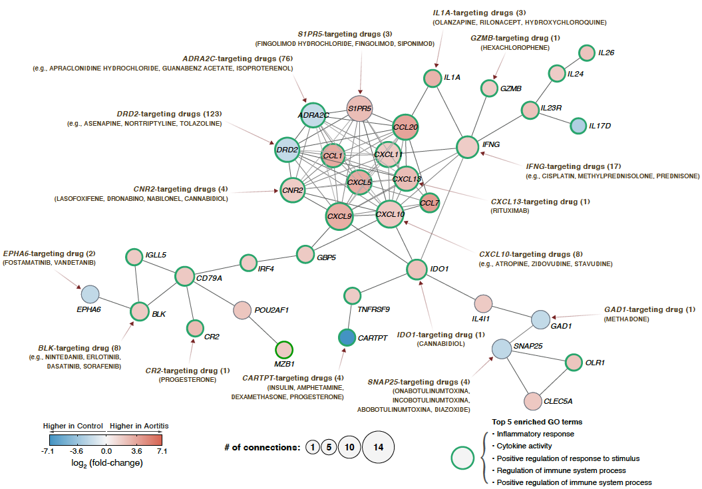
Figure 6.
Figure 6. PPI-based pharmacogenomic network uncovers the gene-drug interaction landscape in aortitis.
8
Notes:
And Figure 6 was a pharmacogenomic network created by PPI.

Slide 11
Misc.

Slide 12
Represents DEGs between HC vs. GCA; linear model coefficients, P < 0.05
gene | log2fc | adj-p
IL6 | -0.1045204 | 0.86836651
IL6R | 0.85999626 | 0.00047757
IL6ST | -0.0068843 | 0.95751675
gene | log2fc | adj-p
IL12A | 0.0840343 | 0.93818957
IL12B | 0.79428854 | 0.54752627
IL12RB1 | 1.36191321 | 1.09E-05
IL12RB2 | 0.64803779 | 0.00408705
gene | log2fc | adj-p
IL23A | 0.75477374 | 0.02186471
IL23R | 2.47053579 | 0.00013769
gene | log2fc | adj-p
IL17A | 0.11476674 | 0.97522326
IL17B | -1.5224569 | 0.04736021
IL17C | -0.2577331 | 0.89606932
IL17D | -2.8197242 | 0.00489863
IL17F | -0.500024 | NA
IL17RA | 0.44970042 | 0.00065388
IL17RB | 0.25954661 | 0.13745021
IL17RC | -0.7027821 | 9.69E-11
IL17RD | -0.4548054 | 0.01037553
IL17RE | -0.0277863 | 0.90638622
gene | log2fc | adj-p
IL2 | 1.26183818 | 0.19806544
IFNG | 2.00824505 | 1.04E-05
gene | log2fc | adj-p
IL21 | 2.17150698 | 0.20229954
IL22 | 1.70793267 | 0.06369482

Slide 13
Pro-inflammatory cytokines
IL1
INF (alpha, beta, gamma)
IL18
GCSF
gene | log2fc | adj-p
IL1A | 3.19111325 | 4.04E-06
IL1B | 1.36357724 | 0.00079353
gene | log2fc | adj-p
IFNA1 | -0.8004634 | NA
IFNA10 | -0.7437551 | 0.8833184
IFNA13 | 0.40983495 | NA
IFNA14 | 0.37849544 | NA
IFNA16 | -0.3910468 | NA
IFNA17 | 7.82868379 | NA
IFNA2 | -0.1455471 | 0.96329576
IFNA21 | 4.34575443 | 0.0334936
IFNA4 | 4.51193751 | NA
IFNA5 | -0.3684258 | 0.80875735
IFNA6 | 0.65050927 | NA
IFNA7 | -0.7077727 | NA
IFNA8 | -2.144489 | NA
IFNAR1 | 0.3081466 | 0.00032717
IFNAR2 | 0.73424258 | 3.32E-12
IFNB1 | 0.93172685 | 0.55172424
IFNG | 2.00824505 | 1.04E-05
IFNGR1 | 0.56322598 | 6.98E-06
IFNGR2 | 0.53182295 | 1.50E-07
gene | log2fc | adj-p
IL18 | 1.54644534 | 3.15E-15
IL18BP | 0.33946572 | 0.1008962
IL18R1 | 0.73117063 | 0.00059902
IL18RAP | 0.37786144 | 0.40068404
gene | log2fc | adj-p
CSF3 | -0.7876437 | 0.6070498
IL11
gene | log2fc | adj-p
IL11 | -0.1075452 | 0.96192647
IL11RA | -0.5351242 | 3.71E-05
IL17
gene | log2fc | adj-p
IL17A | 0.11476674 | 0.97522326
IL17B | -1.5224569 | 0.04736021
IL17C | -0.2577331 | 0.89606932
IL17D | -2.8197242 | 0.00489863
IL17F | -0.500024 | NA
IL17RA | 0.44970042 | 0.00065388
IL17RB | 0.25954661 | 0.13745021
IL17RC | -0.7027821 | 9.69E-11
IL17RD | -0.4548054 | 0.01037553
IL17RE | -0.0277863 | 0.90638622
TNF (alpha, beta)
gene | log2fc | adj-p
TNF | 0.55397877 | 0.20024196
LTA | 0.93418484 | 0.26830238
IL6
gene | log2fc | adj-p
IL6 | -0.1045204 | 0.86836651
IL6R | 0.85999626 | 0.00047757
IL6ST | -0.0068843 | 0.95751675
IL8
gene | log2fc | adj-p
CXCL8 | -0.0858684 | 0.90079153
Notes:
https://www.thermofisher.com/us/en/home/life-science/cell-analysis/cell-analysis-learning-center/immunology-at-work/proinflammatory-cytokines-overview.html#references

Slide 14
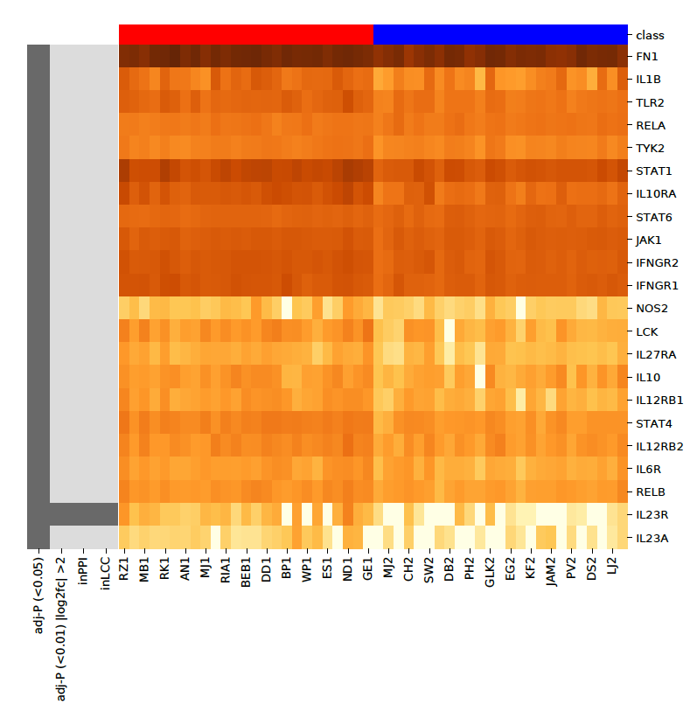
IL12A, IL12, IL23A interacting genes
*genes that are targeted by USTEKINUMAB
Among 7469 DEGs (adj-P < 0.05)
22 DEGs are closely related with
USTEKINUMAB targeting genes
While,
1 are associated with PPI-Network
1 are associated with LCC

Slide 15
Terminology
PPI nodes: Proteins.
PPI edges: Predicted functional associations between two proteins.
indicates the presence of fusion
neighborhood
co-occurrence
experimental text-mining
database evidence
co-expression evidence.

